Slide 1
A Prediction Model for Identifying Adolescent Substance Use Risk Based on Mental Health and Peer Influence

Slide 2
Table of contents
Introduction
Research Questions
Literature Review
Data Analysis
Methodology
Results
Limitations
Discussion
Future Works

Slide 3
INTRODUCTION
Adolescent mental health is a critical global concern, with approximately 20% of adolescents experiencing mental health challenges annually.
Remarkably, nearly 50% of these issues manifest by age 14, increasing to 75% by age 24 [1].
The study's primary aim is to uncover insights into the interplay between early alcohol consumption and mental health outcomes among adolescents aged 11 to 17

Slide 4
Research Question
Does early alcohol consumption during adolescence, as well as the influence of peers and family, significantly impact mental health outcomes among adolescents aged 11 to 17?
How do parental and peer influences impact adolescent alcohol and drug use?
Is there a relationship between early alcohol consumption and mental health outcomes at age 11 and 14 ?

Slide 5
LITRETURE REVIEW
Young people's attitudes and behaviors are initially shaped by families, both directly (in that parents and siblings act as role models) and indirectly (in terms of the levels of support and conflict exhibited in families that subsequently affect the young person). However, reasons and motivations for drinking change as they get older [2].
Studies have consistently shown that adolescents who initiate alcohol consumption at an early age are at a higher risk of developing mental health issues later in life [3]. This association raises important questions about causality and the mechanisms through which alcohol may impact mental well-being.

Slide 6
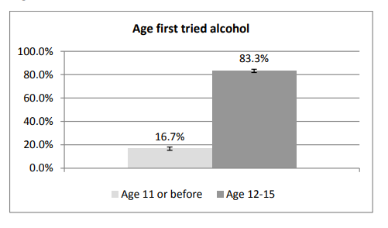
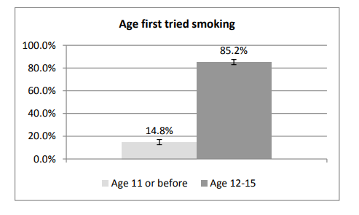
DATA ANALYSIS
Figure 1: Age first tried alcohol
Figure 2: Age first tried smoking

Slide 7
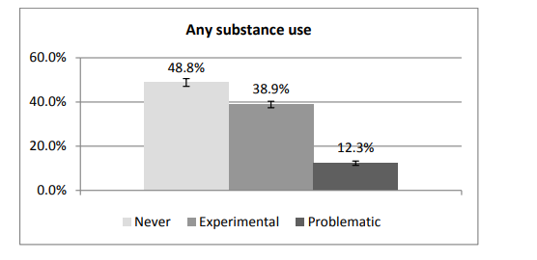
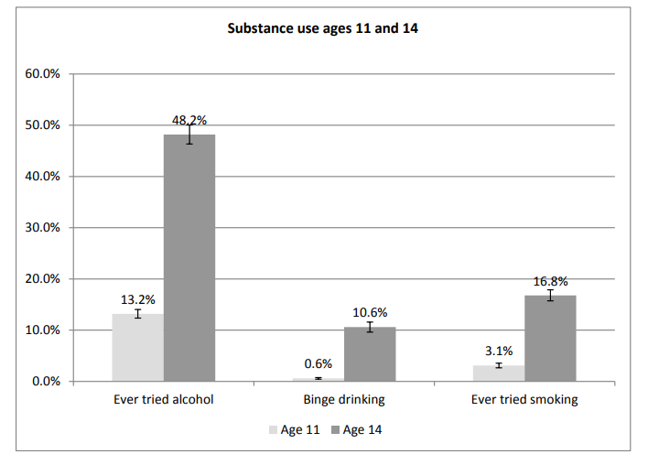
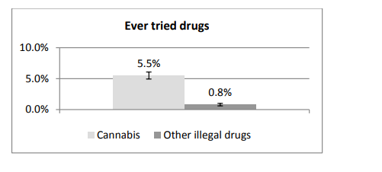
DATA ANALYSIS
Figure 3: Any substance use
Figure 4: Substance use at Ages 11 and 14
Figure 5: Ever tried drugs at age 14

Slide 8
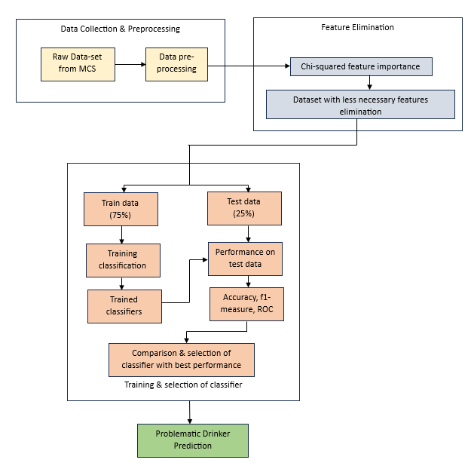
METHODOLOGIES
Figure 6: Overview of Proposed Framework

Slide 9
METHODOLOGIES
Chi-Square Test of Independence: This non-parametric test was employed to assess associations between two categorical variables. A significance level (P-value) of 0.05 was used to evaluate statistical significance. The null hypothesis assumed independence between variables
Cramer’s V Test for Effect Size: This test was used to quantify the magnitude of associations identified by the Chi-Square Test. Cramer’s V provides an effect size measurement, indicating the strength of associations between categorical variables. It addresses the limitation of the Chi-Square Test, which identifies associations but doesn't measure their magnitude.
Table 1: chi-square and Crammer’s V test results

Slide 10
METHODOLOGIES
Variables | P value | V values
Sweep 5
Tried Cigarette | 0.0056 | 0.142
Tried Alcohol | 0.01 | 0.1154
Had more than 5 drinks at a time | 0.01 | 0.1068
Sweep 6
Smoking Frequency | 0.01 | 0.2127
Smoking E cigarettes | 0.01 | 0.1304
Tried Alcohol | 0.003 | 0.2042
Had more than 5 drink at a time | 0.01 | 0.1078
Frequency of 5 drink at a time in 12 months | 0.004 | 0.1913
Tried Drugs | 0.01 | 0.2868
Drug- Cannabis | 0.01 | 0.139
Other Illegal Drug | 0.01 | 0.188
Smoking Frequency | 0.01 | 0.2308
Sweep 7
Tried Cigarette | 0.03 | 0.1184
Smoking Frequency | 0.007 | 0.1832
Tried Alcohol | 0.3 | 0.2578
Had more than 5 drink at a time | 0.08 | 0.1256
Frequency of five drink at a time in last 12 months | 0.0 | 0.1032
Tried Drugs | 0.09 | 0.1204
Frequency of Drugs in last 12 months | 0.01 | 0.1197
Friends – Sweep 5 and Sweep 6
Friends Alcohol Frequency s5 | 0.045 | 0.2856
Friends Smoking Frequency s5 | 0.003 | 0.1568
Friends Alcohol Frequency s6 | 0.01 | 0.2893
Friends Smoking Frequency s6 | 0.05 | 0.1985
Friends Illegal Drug Consumption s6 | 0.01 | 0.1092
Parents – Sweep 5 and Sweep 6
Alcohol Frequency s5 | 0.01 | 0.0792
Alcohol Frequency s6 | 0.01 | 0.0573
Smoking Frequency s5 | 0.01 | 0.0891
Smoking Frequency s6 | 0.01 | 0.0236
Drug Consumption s5 | 0.01 | 0.0104
Drug Consumption s6 | 0.01 | 0.0119
Table 1: chi-square and Crammer’s V test results

Slide 11
METHODOLOGIES
Objective of Classifier Model: The objective was to construct a classifier model that predicts participants' alcohol patterns at age 17 using a predetermined set of features.
Data Imputation: Two methods of data imputation, mode imputation, and KNN (K-Nearest Neighbors) imputation were explored to address missing data. KNNImputer was chosen as the preferred method.
Class Imbalance: Significant class imbalance was addressed by oversampling the minority 'Problematic' class using the Synthetic Minority Oversampling Technique (SMOTE). This enhanced classifier performance.
Data Partitioning: The dataset was divided into a training dataset (75%) and a test dataset (25%). Five machine learning classification algorithms were employed on the training dataset: Random Forest, Decision Tree, K-Nearest Neighbour, Naïve Bayes, and Logistic Regression.

Slide 12
METHODOLOGIES
Binary Classifier: Binary classifiers were created using Sci-kit library functions, capable of predicting the likelihood of an individual being categorized as 'normal' or 'abnormal' based on feature variables.
SHAP Values: SHAP (Shapley Additive Explanations) values were used to assess feature importance and impact. They provide insights into whether mental health-related factors had positive or negative associations with mental health outcomes.
Random Forest Performance: The Random Forest model emerged as a robust performer, with detailed performance metrics to be discussed in the results section.

Slide 13
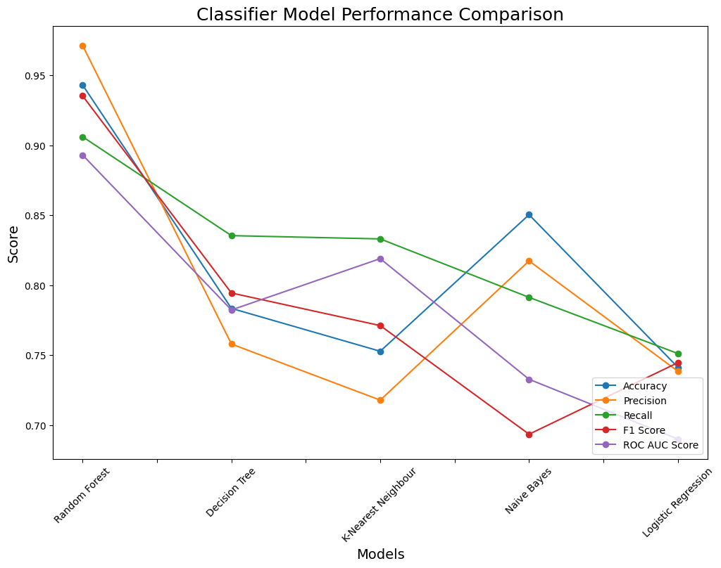
METHODOLOGIES
Classifier | Accuracy | Precision | Recall | F1 Score | Roc AUC Score
Random Forest | 0.87 | 0.89 | 0.85 | 0.87 | 0.94
Decision Tree | 0.86 | 0.87 | 0.85 | 0.86 | 0.80
Naïve Bayes | 0.73 | 0.81 | 0.60 | 0.69 | 0.81
Logistic Regression | 0.78 | 0.78 | 0.77 | 0.76 | 0.86
K Nearest Neighbour | 0.82 | 0.91 | 0.72 | 0.80 | 0.85
Figure 7: Classifier model performance comparison line graph
Table2: Models performance metrics table

Slide 14
RESULTS
SHAP Values: SHAP (SHapley Additive exPlanations) values were used to assess the influence of specific features as predictors in the Random Forest classifier.
SHAP values help to interpret individual predictions by indicating the contribution of each feature towards a prediction outcome.
Negative SHAP values indicate a contribution towards one class (e.g., 'Problematic'), while positive values signify a contribution towards the other class (e.g., 'Experimental’).
These values were instrumental in understanding whether relationships between mental health-related factors and mental health exhibited positive or negative associations.

Slide 15
RESULTS
Model Selection: The Random Forest classifier was chosen as the final model after addressing data challenges. The model was trained on oversampled data, and SHAP values were obtained from the original class proportions to maintain integrity.
Evaluation Metrics: Accuracy alone doesn't suffice for binary classification; precision, recall (TPR), TNR, and the F1-score are crucial. The confusion matrix helps interpret these metrics.
Classifier Comparison: Various classifiers were evaluated, with Random Forest outperforming others. ROC curve analysis, Precision-Recall curves, and the F1-measure aided in classifier selection.

Slide 16
RESULTS
Feature Importance: "Ever_alcohol_drink" (Sweep 6) emerged as the most influential feature, followed by "Parents Alcohol" (Sweep 5 and 6) and "Friends Drink" (Sweep 5). "Tried Alcohol" (Sweep 5) and "Alcohol Frequency in 4 weeks" (Sweep 5) were the least significant.
Impact of Features: Dependency graphs revealed associations between features. For example, "Ever 5 plus alcohol" was linked to later alcohol dependency. Parental alcohol patterns influenced adolescent drinking. Alcohol consumption at age 14 correlated with mental health at ages 17.
Final Banding and Mental Health: Cohort members categorized as 'abnormal' in mental health were more likely to exhibit problematic substance use patterns during late adolescence.

Slide 17
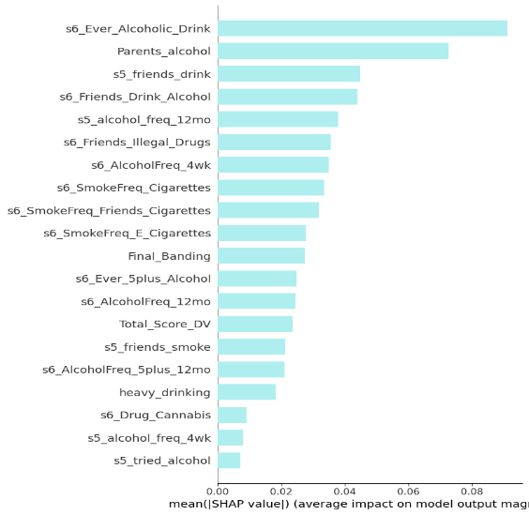
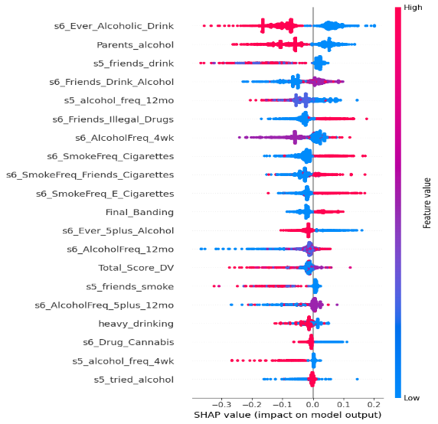
RESULTS
Figure 8: Feature importance bar graph
Figure 9: SHAP values summary graph

Slide 18
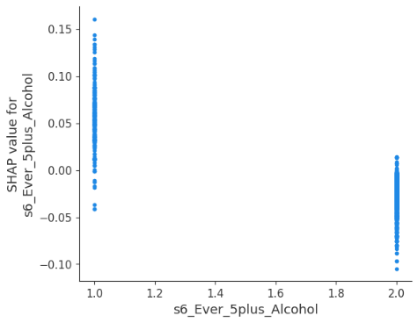
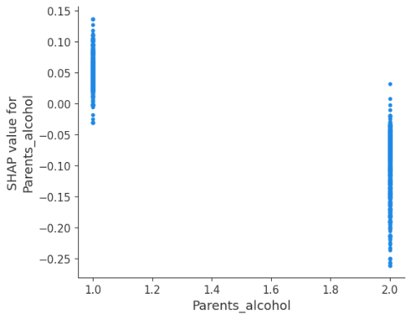
RESULTS
Figure 10: 5 plus drinks
Figure 11: Parents Alcohol

Slide 19
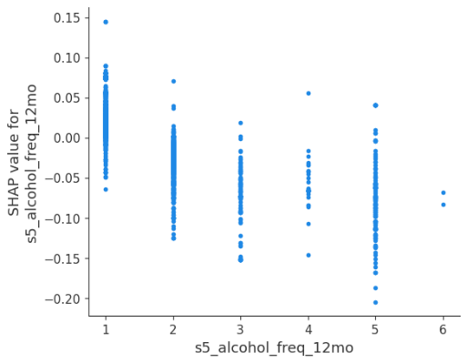
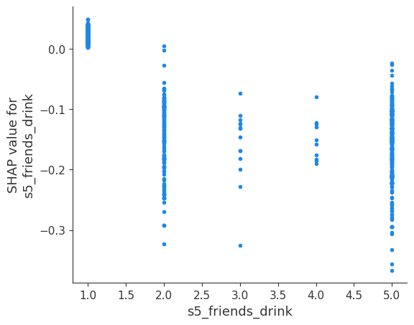
RESULTS
Figure 12: Alcohol Frequency in last 12 months
Figure 13: Friends Alcohol

Slide 20
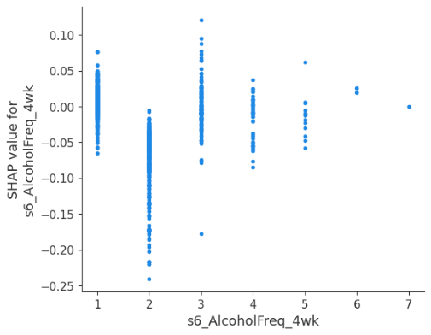
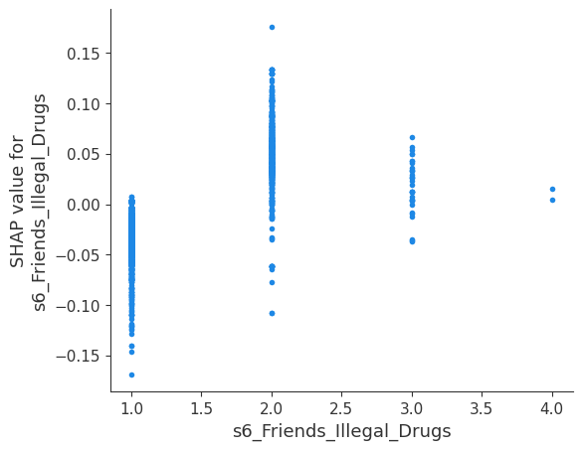
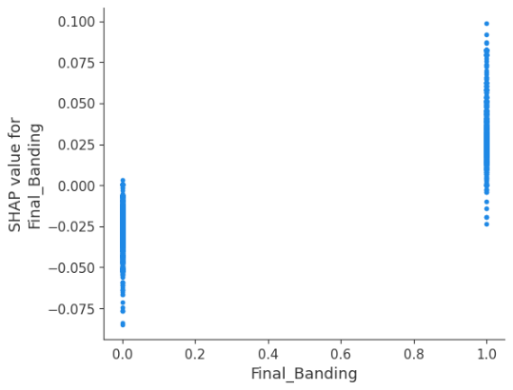
RESULTS
Figure 20: Alcohol Frequency in last 4 weeks
Figure 21: Friends illegal drugs
Figure 22: Mental health

Slide 21
LIMITATION
Data collected through surveys and interviews may introduce recall and social desirability biases.
The study relies on participants' recollections, which may be less accurate over time
Findings are specific to the Millennium Cohort Study cohort, limiting generalizability to other populations or cultural contexts.
The study primarily covers adolescence and does not extend into adulthood.

Slide 22
DISCUSSION
The study affirms a strong link between adolescent alcohol use and mental health issues, emphasizing the predictive value of early alcohol initiation for later dependence.
Both peer and family dynamics significantly shape alcohol consumption in adolescents.
Peers influence early and frequent alcohol use, aligning with social learning theories.
Family dynamics, including parental behavior, play a key role in adolescent alcohol patterns.
Early alcohol consumption, especially at age 14, correlates with later mental health problems at ages 17.

Slide 23
FUTURE WORK
Future research can employ longitudinal designs to explore causal relationships in more depth.
Conducting long-term follow-up studies tracking participants into adulthood can reveal the persistence of associations and their implications for later life.

Slide 24
References
2022 National Healthcare Quality and Disparities Report [Internet]. Rockville (MD): Agency for Healthcare Research and Quality (US); 2022 Oct. CHILD AND ADOLESCENT MENTAL HEALTH. Available from: https://www.ncbi.nlm.nih.gov/books/NBK587174/
Telzer EH, van Hoorn J, Rogers CR, Do KT. Social Influence on Positive Youth Development: A Developmental Neuroscience Perspective. Adv Child Dev Behav. 2018;54:215-258. doi: 10.1016/bs.acdb.2017.10.003. Epub 2017 Dec 6. PMID: 29455864; PMCID: PMC6345387.
Lees B, Meredith LR, Kirkland AE, Bryant BE, Squeglia LM. Effect of alcohol use on the adolescent brain and behavior. Pharmacol Biochem Behav. 2020 May;192:172906. doi: 10.1016/j.pbb.2020.172906. Epub 2020 Mar 13. PMID: 32179028; PMCID: PMC7183385.

Slide 25
THANK YOU

